Slide 1
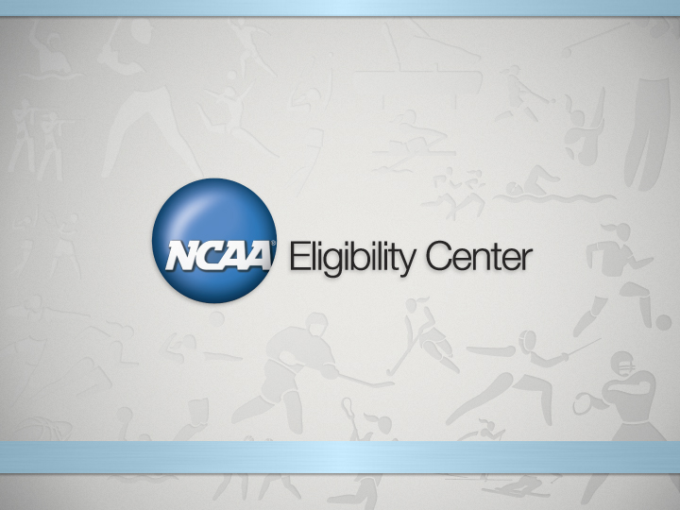
ROADMAP TO INITIAL ELIGIBILITY

Slide 2
NCAA Eligibility Center Responsibilities
The NCAA Eligibility Center is responsible for determining the eligibility of every college-bound student-athlete in NCAA Divisions I and II using the following two areas:
Academic Certification:
Does the college-bound student-athlete meet the legislated minimum academic requirements?
Amateurism Certification:
Has the college-bound student-athlete jeopardized his or her amateur status?

Slide 3
Academic Requirements
Academic initial-eligibility requirements are different for each of the three divisions.
It is possible for a college-bound student-athlete to be eligible in one division and not another.

Slide 4
Academic Requirements
Graduate from high school.
Complete NCAA-approved courses.
Earn a minimum required core-course grade-point average (GPA).
Earn a required SAT or ACT sum score.

Slide 5
Definition of a Core Course
A course that qualifies for high school graduation in one or more of the following: English, mathematics, natural or physical science, social science, foreign language or comparative religion or philosophy;
Is considered four-year college preparatory;
Is taught at or above the high school’s regular academic level;
For mathematics courses, is at the level of Algebra I or higher; and
Is taught by a qualified instructor as defined by the appropriate academic authority.

Slide 6
Division I Core-Course Requirements
16 Core Courses
4 years English.
3 years math (Algebra I or higher).
2 years natural/physical science (1 year of lab if offered by high school).
1 year additional English, math or natural/physical science.
2 years social science.
4 years additional courses (from any area above, foreign language or comparative religion/philosophy).

Slide 7
NEW Division II Core-Course Requirements
16 Core Courses
3 years English.
2 years math (Algebra I or higher).
2 years natural/physical science (1 year of lab if offered by high school).
3 years additional English, math or natural/physical science.
2 years social science.
4 years additional courses (from any area above, foreign language or comparative religion/philosophy).

Slide 8
Core-Course GPA and Test Scores
Division I
Earn a combined SAT or ACT sum score that matches your core-course GPA and test-score sliding scale.
For example, a 2.400 core-course GPA needs an 860 combined SAT score OR 71 combined ACT score.
- Beginning August 1st, 2016, 10 core courses to be completed prior to the seventh semester and seven of the 10 must be a combination of English, Math, and natural or physical science.
Division II
Earn a 2.000 GPA or better in your core courses.
Earn a combined SAT score of 820 or an ACT sum score of 68.

Slide 9
Core-Course GPA and Test Scores
Best Test Scores Will Be Used to Certify Students
Test Score
English Math Reading Science Composite SUM
ACT 9/10/11 27 25 21 18 23 91
ACT 10/22/11 24 26 23 20 23 93
________________________________________________________
Scores Used 27 26 23 20 96

Slide 10
Division III Core-Course Requirements
Unlike Divisions I and II, there is no uniform set of eligibility requirements for Division III schools.
Eligibility for admission, financial aid, practice and competition is determined by the college or university.

Slide 11
NAIA Initial Eligibility Requirements
High School Students
If you will graduate from high school this spring and enroll in college this coming fall, the requirements are simple. High school graduation, plus two out of three of these requirements:
Achieve a minimum of 18 on the ACT or 860 on the SAT
Achieve a minimum overall high school GPA of 2.0 on a 4.0 scale
Graduate in the top half of your high school class
More information available at www.playnaia.org

Slide 12
Steps Students Must Take to Participate in NCAA Division I or II Athletics
Freshmen and Sophomores:
Start planning now!
Tell student’s to work hard to get the best grades possible.
Take classes that match ISD’s NCAA List of Approved Core Courses. The NCAA Eligibility Center will only use approved core courses to certify initial eligibility.
Student’s should access and print ISD’s NCAA List of Approved Core Courses at www.eligibilitycenter.org under the “resource” tab.

Slide 13
Steps Student’s Must Take to Participate in NCAA Divisions I or II Athletics
Juniors:
At the beginning of the junior year, register at www.eligibilitycenter.org and complete the amateurism questionnaire.
Register to take the ACT, SAT, or both, and use the Eligibility Center code “9999” as a score recipient.
Double check to ensure enrollment in courses that match ISD’s NCAA List of Approved Core Courses.
Request that your high school guidance counselor send an official transcript to the Eligibility Center after completing your junior year. (The Eligibility Center does NOT accept faxed transcripts.)

Slide 14
Steps Student’s Must Take to Participate in NCAA Divisions I or II Athletics
Seniors:
At the beginning of the senior year, check with the counselor and the Eligibility Center to determine the amount of core courses that need to be completed the senior year.
Take the SAT and/or ACT again. The Eligibility Center will use the best scores from each section of the ACT or SAT to determine your best cumulative score.
Continue to take core courses.
Ensure enrollment in courses that match ISD’s NCAA List of Approved Core Courses.

Slide 15
Steps Student’s Must Take to Participate in NCAA Divisions I or II Athletics
Seniors:
Review the amateurism questionnaire responses and request final amateurism certification beginning April 1 (for fall enrollees) or October 1 (for spring enrollees).
Continue to earn the best grades possible.
After graduation, the student must request the final transcript with proof of graduation be sent to the NCAA.
Graduate on time (in eight academic semesters).

Slide 16
Core-Course Time Limitation
Division I
From the time a student enters the ninth grade, he/she has four (4) years or eight (8) semesters to complete his/her core-course requirement. If the student fails to complete high school "on time" in eight semesters, core courses taken after the eighth semester will not be counted toward his/her NCAA academic eligibility requirements.
“On time" also means that if the student’s high school graduation takes place June 1, he/she must graduate June 1. If the student does not graduate June 1 with the rest of his/her high school class, the student’s academic requirements have not been completed "on time."
Division II
A student is permitted to use all core courses completed from his/her ninth grade year until the time he/she enrolls full time at a college or university.

Slide 17
Register with the NCAA Eligibility Center
Starting at the beginning of the junior year:
Log on to www.eligibilitycenter.org
Select the link for college-bound student-athletes to enter.
Then click the “New Account” button at the top right of the screen or the cell phone on the left side of the screen.
Follow the instructions to complete the registration process.

Slide 18
NCAA Eligibility Center Registration
Students click here to create an account
Or Here

Slide 19
Complete the Amateurism Questionnaire
When students register, be sure they complete the amateurism questionnaire.
Log in and click on “Enter/Update Amateur Questionnaire.”
Answer the questions honestly. Don’t let anyone else complete this for you (the student).
Students should review amateurism questionnaire responses and request final amateurism certification during the senior year (beginning April 1 for fall enrollees and beginning October 1 for spring enrollees).

Slide 20
Amateurism
The Eligibility Center encourages students to update their athletics participation information often, especially if they participate in events outside the normal high school season.
Students should meet high school guidance counselor often.
Stay college eligible – tell students “always ask before you act!”
NCAA Amateurism Certification Web site: www1.ncaa.org/membership/ach/index.html.

Slide 21
ALWAYS ASK BEFORE YOU ACT! Amateurism Red Flags
Ask questions before:
Signing a contract with a professional team. Receiving money for participating in athletics. Receiving prize money above actual and necessary expenses. Playing with professional athletes. Trying out, practicing or competing with a professional team. Receiving benefits from an agent or prospective agent. Agreeing to be represented by an agent. Participating in organized competition after your first opportunity to enroll in college.

Slide 22
Recruiting
ISD Students become a “prospective student-athlete” when:
start of ninth-grade classes; or
Before the ninth-grade year, a college offers the student, the student’s relatives or student’s friends any financial aid or other benefits that the college does not provide to students generally.

Slide 23
NCAA Calculator
Division I Status
Division I Core GPA: 3.95
Division I Minimum SAT Score: 400
Your SAT Score: No Score
Division I Minimum ACT Score: 37
Your ACT Score: No Score

Slide 24
Resources
Eligibilitycenter.org for college-bound student-athletes to complete their registration and check their status with the NCAA Eligibility Center. Also to download and print a copy of the 2011-12 Guide for the College-Bound Student-Athlete.
Actstudent.org (ACT)
Collegeboard.com (SAT)
National-letter.org (National Letter of Intent)
Playnaia.org (NAIA)
Ncaacalculator.com (NCAA status and Core GPA)

Slide 25
